Slide 2
3D blade model updating by coupling HAWC2 and ABAQUS
Maria Luz Castilla Mena (s212601@dtu.dk)
Notes:
Hi, I am Maria and I am going to present my master thesis topic: Evolution of blade cracks with wind turbine simulation tolos (this is a provisional titile, it needs to be discussed)

Slide 3
INDEX
From last meeting
Progress of the project
For the next meeting

Slide 4
From last meeting
Objective: carry out simulations to predict the behaviour of a wind turbine blade under certain wind conditions, using an aeroelastic software as HAWC2 to calculate the aerodynamic loads and a structural software as ABAQUS to calculate the material stiffness and deformation of the blade
Significance: these simulations can help in the decision process of repairing a wind turbine blade before or after the storm
Added value to the research community: creating an interface to predict the behaviour of wind turbine blades under certain wind conditions

Slide 5
From last meeting
Replicate a real wind gust profile in HAWC2
If free time, keep working on the MATLAB code

Slide 6
Progress of the project

Slide 7


Progress of the project
Replicate a real wind gust profile in HAWC2
If time, keep working on the MATLAB code

Slide 8
Challenges
Replicate a real wind gust profile in HAWC2
Hard to find realistic wind profiles
Long time simulations: shorter: 600sec, which is reasonable (20 minutes long to run in HAWC2)
Expert in HAWC2 manual: doubts with some specifications
If time, keep working on the MATLAB code
Problems with the restart option
If we change the approach of the Master Thesis, it can be solved

Slide 9
2 approaches
Approach 1: for each iteration, apply new wind profile in the previous deformed setup
Not possible: not able to save previous wind conditions in HAWC2
Approach 2: (the one we are considering at the moment)
Day 1: wind profile, apply moments to section and extract structural results, unload
Day 2: different wind profile, apply new moments to section and extract new structural results.
Difference from Approach 1: you don’t apply new loads to the deformed beam, but you still considered the structural effects from the previous day.

Slide 10
Results

Slide 11
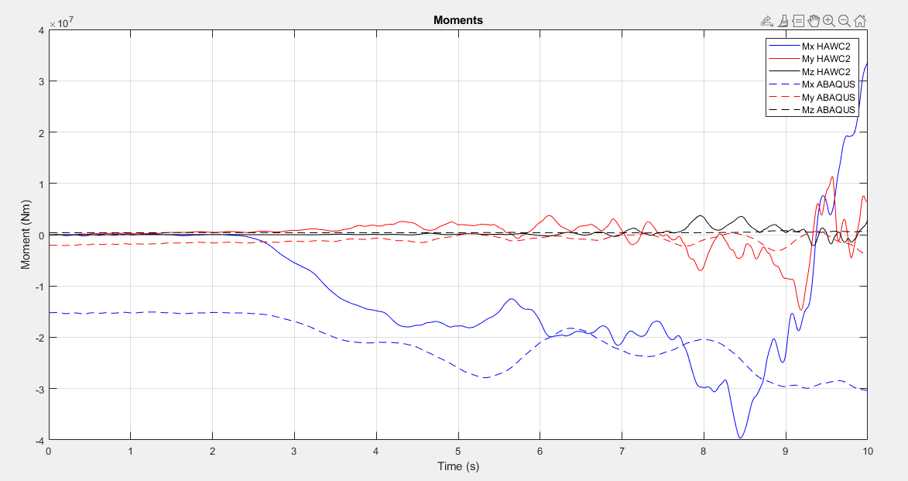
Approach 1
Job 2 (=Day 2)
Same amplitude name (this means overwriting the previous ones)
Weird pattern

Slide 12
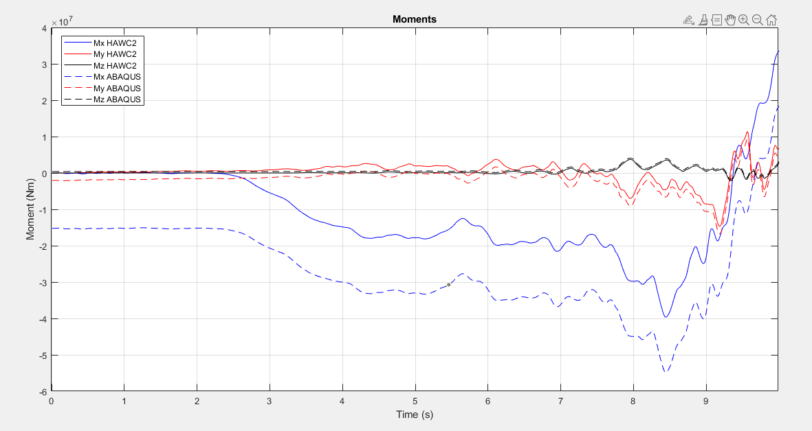
Approach 1
Job 2 (=Day 2)
Different amplitude name (this means not overwriting the previous ones)
Offset due to the previous job:
the last value remains constant in the next job

Slide 13
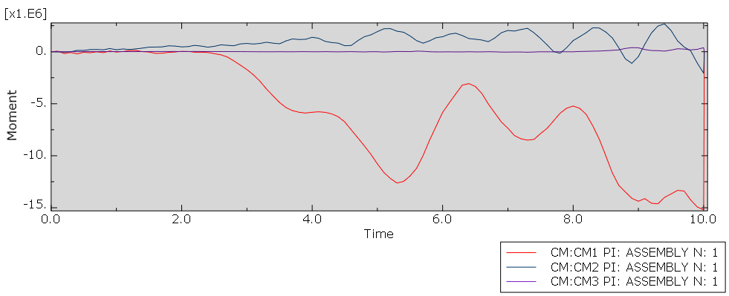
Approach 2
Job 1 (=Day 1)
Solution: Added additional step to unload the beam between jobs

Slide 14
Approach 2
Problems with the OP=NEW option
Is it necessary to restart from the previous job, if the beam was unloaded in the last time step? (=no deformation)

Slide 15
Wind profile replication
Modified:
Turbulence intensity (=standard deviation/mean wind speed)
Turbulence parameters I think not needed to be modified, confirm with expert
Shear profile (always logarithmic, the most accurate method)
To modify:
Try changing wind factors, study the behaviour in certain sections and try to be as accurate as possible in HAWC2
Is there a more efficient way?

Slide 16
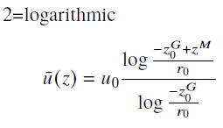
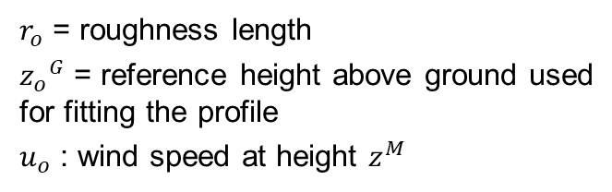
Wind profile replication
Wind profile: Tarifa 1197 (600sec)
WSP (Mean wind speed): 7.78 m/s
Standard deviation: 0.72 m/s
HAWC2 parameters
WSP = 7.78 m/s
Turbulence intensity = WSP/Standard deviation = 0.0925
Shear profile: logarithmic
$r_{o}$ = roughness length
${z_{o}}^{G}$ = reference height above ground used for fitting the profile
$u_{o}$ : wind speed at height $z^{M}$

Slide 17
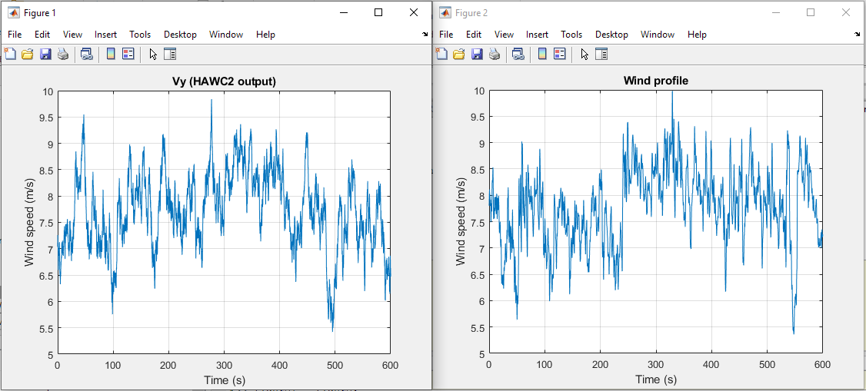
HAWC2 replicate
Original wind profile

Slide 18
HAWC2 replicate
Original wind profile

Slide 19
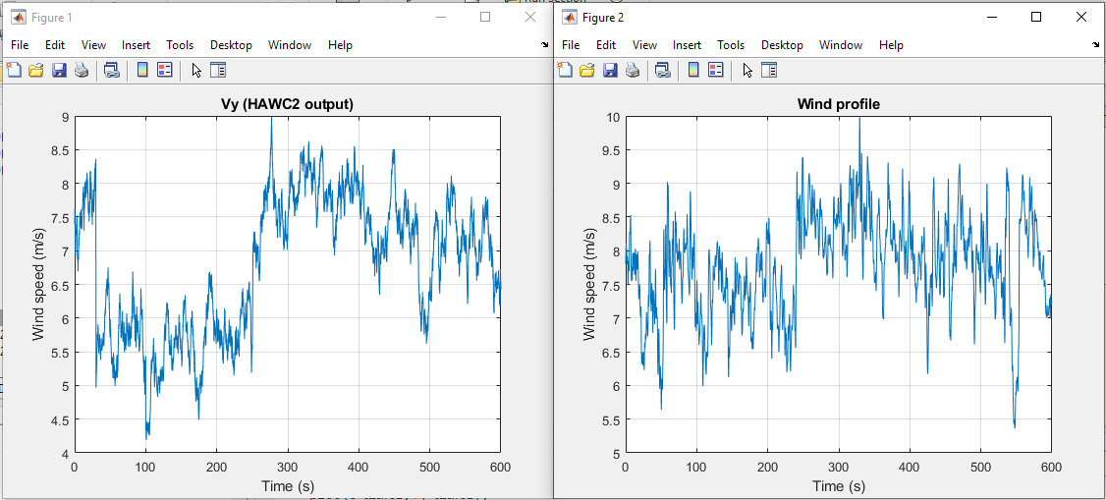
HAWC2 replicate
Original wind profile

Slide 20
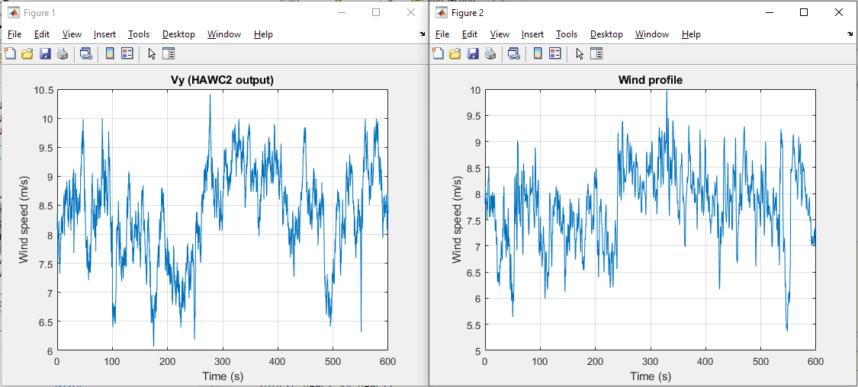
HAWC2 replicate
Original wind profile

Slide 21
Regarding HAWC2 doubts
Right now using the cross-sectional moments in local coordinates of the blade
Double check with HAWC2 expert differences between global and local coordinates
Not possible to obtain strains
Need an expert that knows the specifications written in the HAWC2 manual

Slide 22
For next meeting…

Slide 23
For the next meeting
How to make replication of wind profiles more efficient
Import wind profiles in HAWC2?
Run HAWC2 in cluster to save time when running simulations?
Hail in storms?
Suggestions?

